Slide 1

Predicting Audience Reception
for Content Acquisition
A Predictive Analytics Approach Using IMDb Big Data & Apache Spark
Project Presentation | May 2026

Slide 2
Agenda
Part I: Business Part
Problem Statement
Project Objective
Business Value & Stakeholders
Part II: Technical Part
Dataset Overview
Data Pipeline & Feature Engineering
Predictive Modeling
Clustering & Segmentation
Evaluation & Visualization

Slide 3
Part I
Business Context
Understanding the business problem and value proposition

Slide 4
The Problem
How can a streaming enterprise estimate the likely
audience reception of a title before acquiring it?
Acquisition decisions rely on limited manual judgment and brand reputation
No systematic method to predict audience reception before purchase
High financial risk: poor acquisitions waste budget and reduce viewer retention
Growing competition among platforms demands data-driven content strategy

Slide 5



Project Objective
Build a predictive analytics system that helps acquisition managers and content strategists make better content selection decisions using historical metadata.
Predict
Identify
Support
Estimate audience reception ratings before acquisition
Characteristics associated with stronger audience reception
Data-driven prioritization of acquisition candidates

Slide 6
Business Value & Stakeholders
Value Proposition
Key Stakeholders
Reduce acquisition risk with data-backed predictions
Acquisition Managers
Direct users for acquisition decisions
Optimize content budget allocation across genres
Content Strategists
Portfolio planning and genre mix
Improve viewer satisfaction and platform retention
Finance Teams
ROI forecasting for content investment
Competitive advantage through predictive intelligence
Executive Leadership
Strategic content direction

Slide 7
Part II
Technical Approach
Data, models, and implementation details

Slide 8
Dataset: IMDb Non-Commercial Datasets
10M+
80M+
1.4M+
7
Title Records
Cast & Crew
Rated Titles
Linked Tables
Table | Description | Key Fields
title.basics | Core title metadata | titleType, genres, runtime, year
title.ratings | Audience ratings | averageRating, numVotes
title.crew | Directors & writers | directors, writers (nconst IDs)
title.principals | Cast & key crew | nconst, category, characters
name.basics | Person metadata | primaryName, birthYear, knownForTitles

Slide 9
Dataset: IEEE DataPort (IMDb Users' Ratings Dataset)
4.67M+
1.49M+
351K+
1
Total Ratings
Unique Users
Unique Titles
NumPy File
Structure / Step | Description | Key Fields & Metrics
Raw Data (Dataset.npy) | Raw comma-separated user rating logs stored in a NumPy array. | userId, titleId, userRating, date
Parsed Ratings Table | Cleaned tabular format mapping individual user scores to specific IMDb titles. | userId, titleId, userRating
Title Aggregations | Statistical features grouped by title to measure overall audience reception. | userRatingCount, userRatingMean, userRatingStd, userRatingRange
Extreme Ratings | Metrics capturing highly polarizing user scores (ratings ≤ 2 or ≥ 9). | extremeRatingCount, extremeRatingRatio

Slide 10
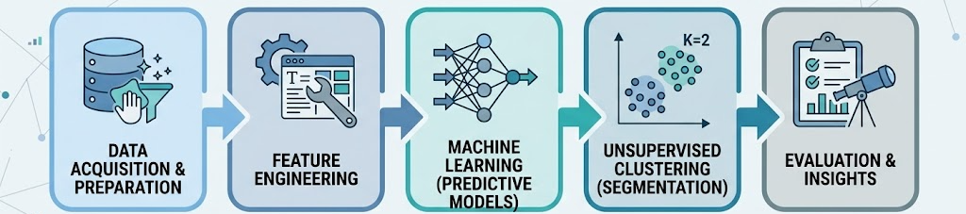
Data Pipeline Overview
Technology Stack
Apache PySpark • Spark SQL • Spark MLlib • Python • Jupyter Notebooks

Slide 11
Feature Engineering
Title Metadata
Crew Statistics
Engagement Signals
Genre indicators (one-hot)
Director avg. rating history
Number of votes (log)
Runtime (minutes)
Director title count
Individual user rating average
Title type (movie/series)
Cast avg. rating
Extreme rating ratio
Release period / decade
Total cast size (numPrincipals)

Slide 12
Predictive Modeling
Supervised learning models to estimate audience reception — predicting ratings directly or classifying into rating groups.
Model | Type | Strengths | Use Case
Linear Regression | Regression | Interpretable, fast baseline | Direct rating prediction
Decision Tree | Regression / Classification | Captures non-linear patterns | Rating prediction & tier classification
Random Forest | Ensemble | Robust, handles noise well | Primary prediction model
GBT Regressor | Ensemble | High accuracy, minimizes errors | Advanced rating prediction

Slide 13
Predictive Modeling
Supervised learning models to estimate audience reception — predicting ratings directly or classifying into rating groups.
Model | Type | Strengths | Use Case
Linear Regression | Regression | Interpretable, fast baseline | Direct rating prediction
Decision Tree | Regression / Classification | Captures non-linear patterns | Rating prediction & tier classification
Random Forest | Ensemble | Robust, handles noise well | Primary prediction model

Slide 14
Clustering & Segmentation
1. By Quality & Prestige (Director Record + Ratings)
Cluster A
The Modern Prestige
Cluster B
The Classics
Represents High-quality, contemporary theater releases (127m, 6.68 Rating).
Represents Acclaimed "Golden Age" films (Avg. Year: 1967).
Cluster C
"B-Movie" Flops
Lower-tier modern content to avoid (4.51 Rating).

Slide 15
Clustering & Segmentation
2. By Production Format (Runtime + num role types)
Cluster A
90-Minute Filler
Cluster B
TV Series
The bulk of the catalog; standard length, below-average quality
1-hour episodic formats; generally yield higher ratings (6.71).
Cluster C
Box Sets
Cluster D
Cinema Releases
Multi-part series and extended documentaries (12+ hours).
130-minute average runtime and high vote volumes . Big-budget, feature-length cinema.

Slide 16
Clustering & Segmentation
3. By Audience Reception (Votes + Ratings)
Cluster A
Global Blockbusters
Cluster B
Niche Masterpieces
The top 1%; massive engagement and high ratings (7.45).
Exceptional ratings (8.26) but very low mainstream visibility.
Cluster C
The Mainstream
The majority of titles (~158k) with moderate engagement and average ratings.

Slide 17
Clustering & Segmentation
4. By Temporal Trends (Release Year + Runtime + Engagement (numVotes))
Cluster A
The Modern Hits
Cluster B
The Contemporary Bulk
Recent (2009), massive audience attention, strong ratings (6.57). The pop-culture drivers.
The modern content explosion (2011). Longer runtimes (122m) but entirely average ratings (5.93).
Cluster C
The Mid-Century Archive
The reliable back-catalog. Older titles (1965) with a tight 92m runtime and solid ratings (6.23).

Slide 18
Clustering & Segmentation
5. By Value for Money (Satisfaction (user rating) + Production Cost (numPrincipals, cast rating)
Cluster A
Elite Mega-Hits
Cluster B
Hidden Gems
The most valuable IPs. Elite ratings (7.60), massive votes, top-tier directors
Highly efficient acquisitions. Excellent user satisfaction (7.74), solid ratings (6.71), standard runtime (92m).
Cluster C
Poor Investments
Cluster D
The 90s Staples
Library inflaters. Bad ratings (4.23–6.39) and terrible user satisfaction.
Reliable, high-engagement titles from the 90s with strong ratings. Good for platform retention.

Slide 19
Clustering & Segmentation
6. By Genre Format Signature (Runtime Formats)
Cluster A
Acclaimed Dramas
Cluster B
Epics & Long-Form
Small but mighty. 103m films with high ratings (6.82) and top-tier directors (6.71).
Sweeping epics or extended cuts. Very long runtimes (154m) with average ratings (6.06).
Cluster C
The Standard Features
Cluster D
Hour-Long Formats
The bulk of the catalog (90–104 mins), ranging from underperformers (5.58) to solid performers (6.54).
At 74 minutes, TV specials, British television formats, or short documentaries. They have good ratings (6.19).

Slide 20
Evaluation & Visualization
Evaluation Metrics
RMSE & MAE - For measuring regression model prediction error
R² Score - To evaluate the variance explained by the model
Accuracy & F1 - For measuring rating tier classification performance
Silhouette Score - To assess K-Means cluster separation and quality
Final Visual Outputs
Target variable distribution histograms & Runtime boxplots
Genre Popularity vs. Quality bubble charts
Heatmap Confusion Matrix for the best classifier (Random Forest)
K-Means Elbow and Silhouette Analysis trend plots

Slide 21
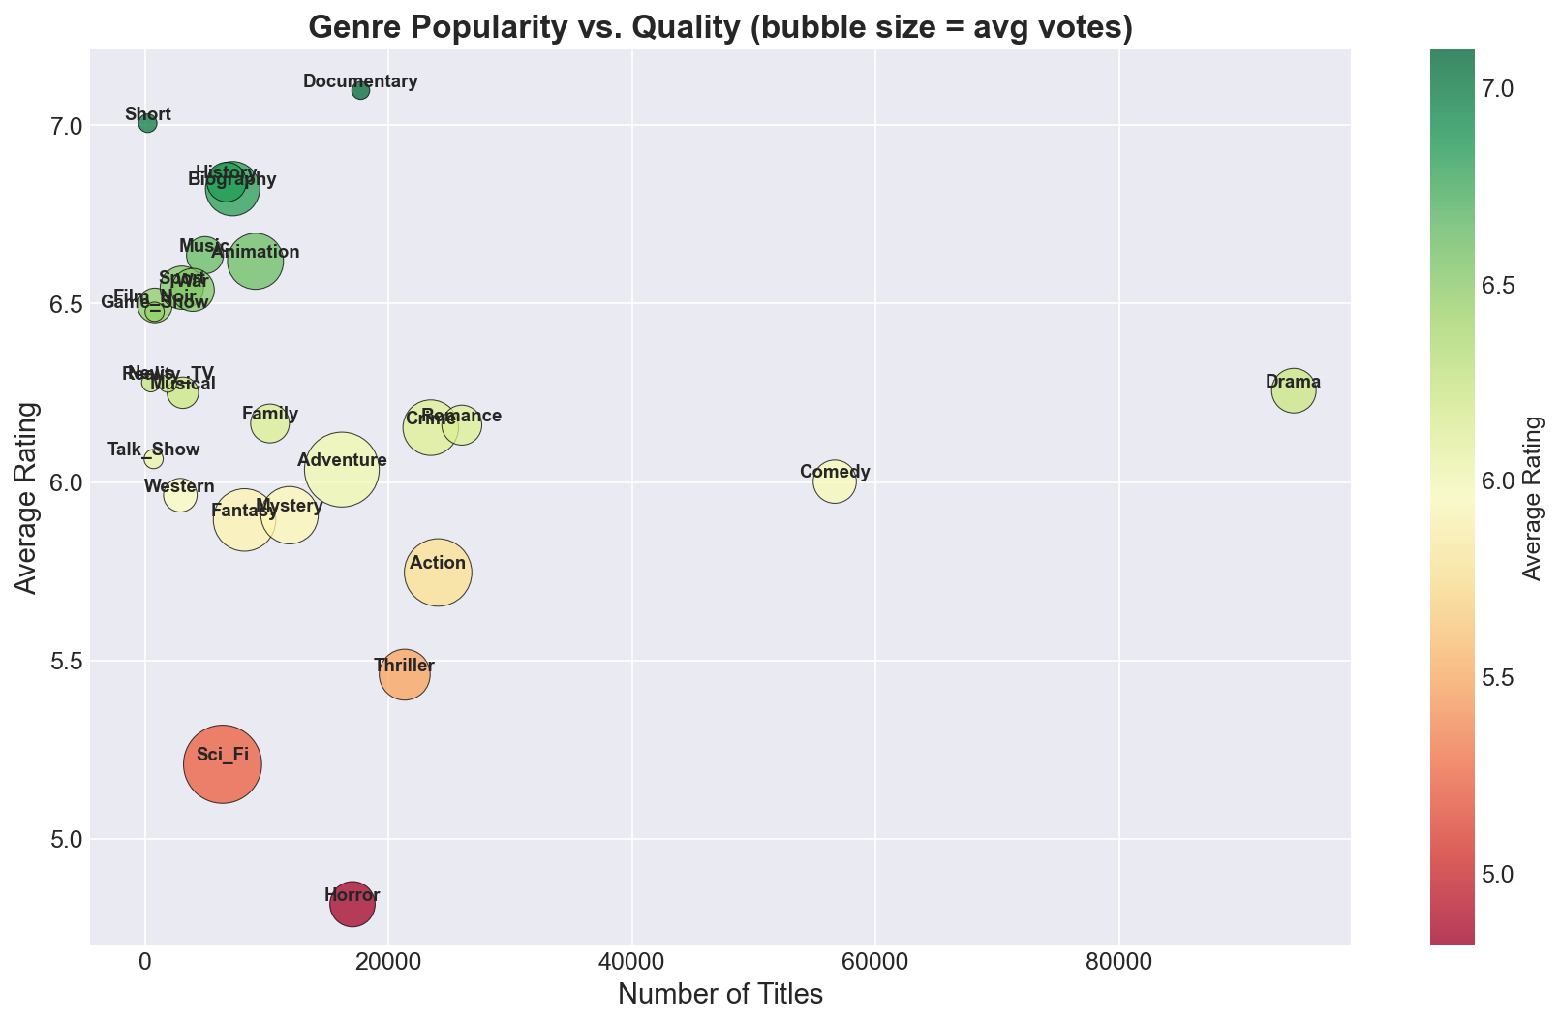
Evaluation & Visualization
Genres Visualization
High engagement ≠ highest quality

Slide 22
Conclusion & Next Steps
This project demonstrates how predictive analytics can transform content acquisition from intuition-driven to data-driven decision making.
Key Takeaways
Next Steps
IMDb data provides rich features for audience prediction
NLP Integration on title summaries and reviews to extract sentiment features
Random Forest expected as the strongest predictor
Addressing Language Bias
Clustering reveals actionable content segments
Build interactive visualization dashboard
Scalable pipeline built on Apache Spark
Explore real-time scoring for new titles

